Slide 1


Project Name : GitConnect
Team Members:
HARSH PANDYA
PARI NIMAVAT
PURVESH PATEL
UMANG PATEL

Slide 2
Introduction
In today’s world, it is very difficult to connect and find developers who can work with us to make an idea into reality. In the same way, it's equally difficult to find the projects on which we can contribute to using our skills.
There should be a platform for developers where they can share the ideas and find other developers to work on that idea as a team.
So here Solution to this problem Our idea of Atmanirbhar bharat :Gitconnect.We providing platform for them to connect and explore.

Slide 3
Development of your techstack
The secure and innovative approach to make website which is user friendly and easy to handle and maintained .We have used
Frontend : React Js: ReactJs is used to develop front-end website for user Interaction adding all the css and better user experience. All webpages render by React development server running on specific port.
Backend : Node js:NodeJS is used as back-end server to handle client requests and give appropriate response to client based on request. NodeJS server run on different port and ReactJS developed on other server.
Database : MongoDB: MongoDB is used for storing user data in JSON object type.

Slide 4
Development
Explanation of the Development of the solution to the problem statement. As well as any changes from the original development plan. From the above-defined problem statement, we are proposing a web-based solution where a different developer can share project definition and also can be a collaborator in a different project.
We are proposing a Web App solution where the developers can share their project definition and find different developers who would like to collaborate in that project.
The owner of the project can set the number of developers and skills needed and can choose from the list of interested developers, who have sent their invitation for collaboration and can start working as a team.
The collaborator can gain a new skill set and a team experience besides this they can ask the owner to provide endorsement for their work.

Slide 5
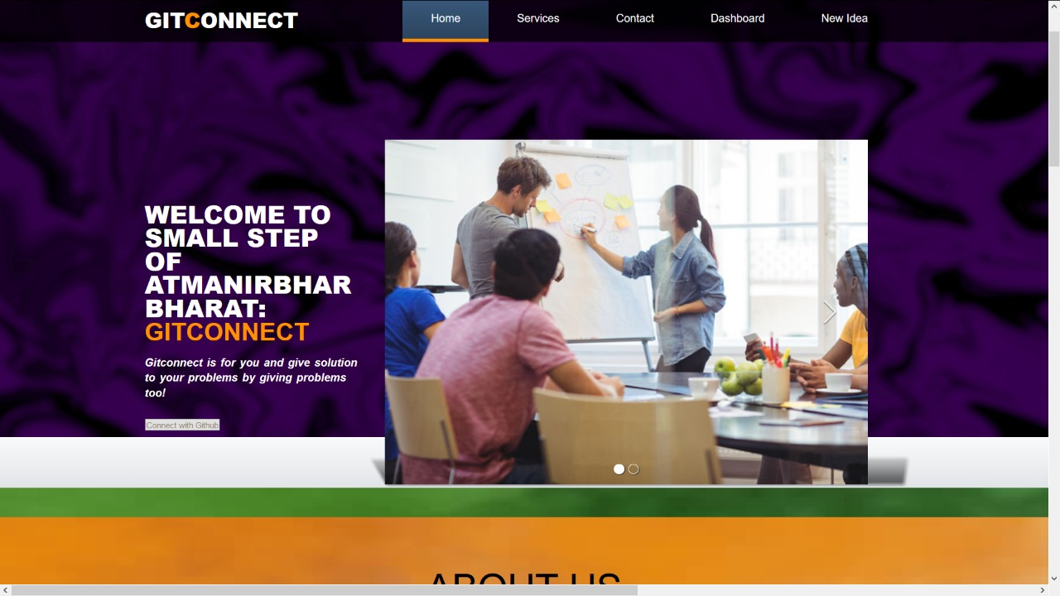
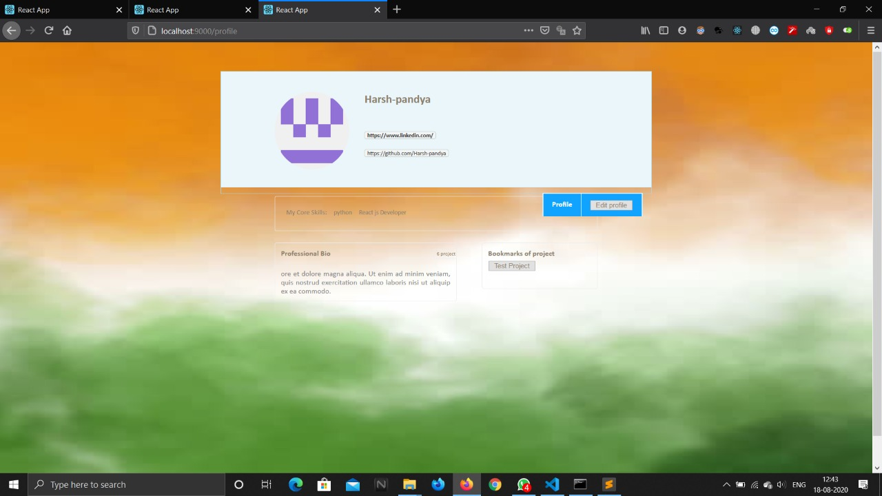
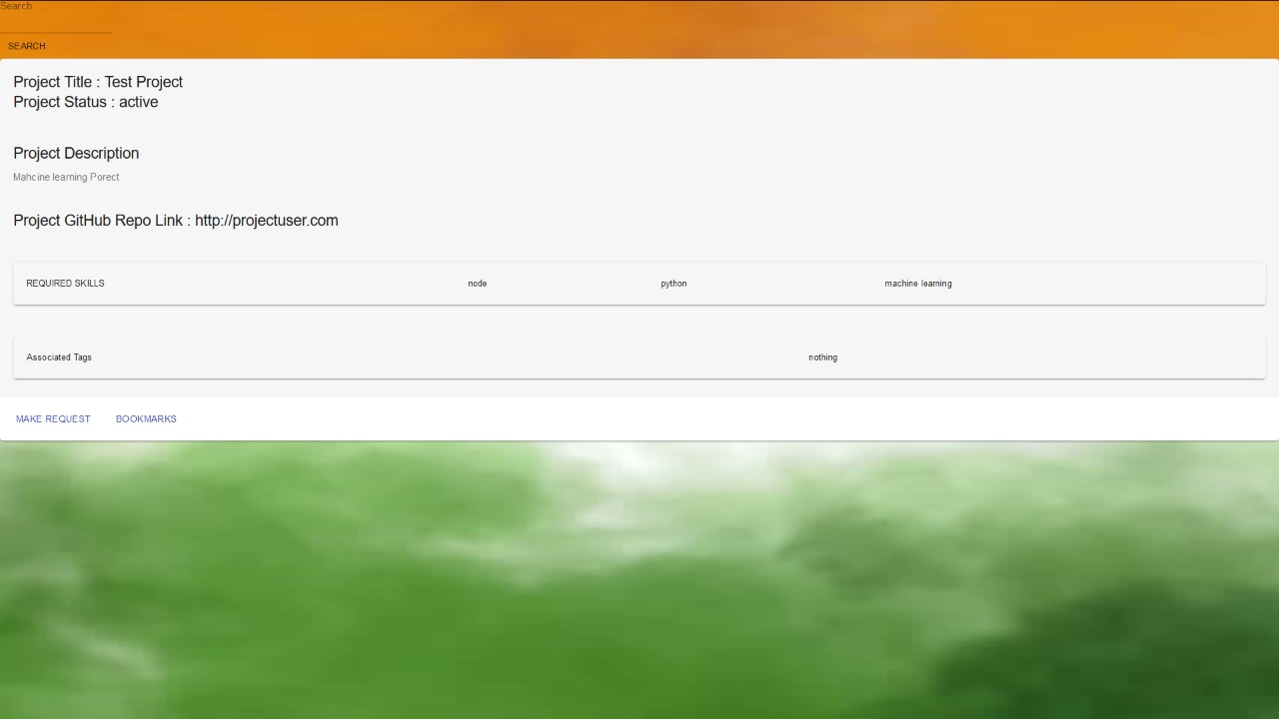
Working
It starts by creating a profile on our website. After that, you can search projects according to your interests and request to collaborate. Also, you can post your idea and other developers can contribute. Some screenshots of website:s
HOME:
PROFILE:
DASHBOARD:

Slide 6
Future scope
The future scope of our project plan for atmanirbhar bharat its persistent as the ideas of great minds are immortal.
The youth of atmanirbhar bharat always seek for ideas,connect to world and to explore there interest hence this platform will always be there constant companion.
As we talk of scalability,we can add numerous recommendations features based on the skills and the interest of the users or trending problem statments.
This platform not only useful for the users but somehow have positive impact on government of india also to explore great people’s ideas and connect to users having extraordinary skills of problem solving to make india a great success as atmanirbhar bharat.

Slide 7
Market Viability
We would like to mention famous saying “Great minds discuss ideas”so giving a platform to this great minds we are here to connect you and share your great ideas and Explore the most realistic problem.
Users will experience a new world of problem and projects to explore and lot of people to interact and connect easily on this platform.
In addition, the developers who have ideas and want to work with people who hav problem solving skills connect on gitConnect.
Giving youth a push to explore new ideas gives new direction of thinking and it will give a whole new dimension to there life these will lead to another success of atmanirbhar bharat.
Here we are for all this users- connect with people and explore at gitConnect.

Slide 8
How our “app” makes India Atmanirbhar
In this situation also India is inevitable and the idea of Atmanirbhar India given by our prime minister, we contribute our small idea but perceivable one to make Atmanirbhar Bharat a great success.
We have millions of developers and students who can come together to resolve a lot of problem statement revolving all over India and as self-reliant policy doesn’t mean cutting off from rest of the world hence we connect all over world users.
This is one cross-platform where the developer and users come under the same umbrella to share and work different project that is developed across different platform and can enhance there skills.
This is propitious for both of the users to connect easily through our website and to work on a common platform and give there contribution to make Atmanirbhar Bharat accomplishment.
To make Atmanirbhar Bharat win one have to learn teamwork with social distancing our website undoubtly gives surety of both the terms with having fruitful outcomes for self reliant India.

Slide 9
THANK YOU!

